Slide 1
Scheduling Theory
ITV Real-Time Systems
Anders P. Ravn
Aalborg University
March 2007

Slide 2
Characteristics of a RTS
Timing Constraints
Dependability Requirements
Concurrent control of separate components
Facilities to interact with special purpose hardware

Slide 3
Real-Time Facilities
Topics
  Notion of time
  Clocks, delays and timeouts
  Specifying timing requirements
  Temporal scopes

Slide 4
Temporal Scopes
Includes:
  deadline for completion of execution
  minimum delay before start of execution
  maximum delay before start of execution
  maximum execution time
  maximum elapse time
Can be
  Periodic
  Sporadic
  Aperiodic
Deadlines can be:
  Hard
  Soft
  Interactive — performance issue
  Firm

Slide 5
Now
Minimum delay
Maximum delay
a
Time
Maximum elapse time
b
c
Maximum execution time = a + b +c
Units of execution
Deadline

Slide 6
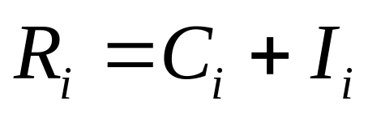
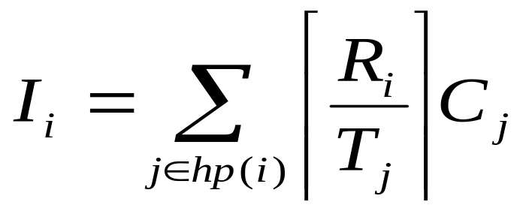
Scheduling
Last Time:
  Simple process model
  The cyclic executive approach
  Process-based scheduling
  Utilization-based schedulability tests
  Response time analysis for FPS
  Worst-case execution time
R ≤ D
i
i

Slide 7
Simple Process Model
The application has a fixed set of processes
All processes are periodic, with known periods
The processes are independent of each other
All processes have deadline equal to their period
All processes have a worst-case execution time.
All context-switching costs etc. are ignored

Slide 8
Sporadic Processes
They have minimum inter-arrival time
They also require D<T
Response Time Analysis – applies
Deadline Monotonic Priority Assignment is Optimal

Slide 9
Aperiodic Processes
No minimum inter-arrival time
Can run at a lowest priority.
Alternative: a server with period T_{s} and capacity C_{s} can be employed. Often with highest priority.

Slide 10
Simple Process Model
The application has a fixed set of processes
Sporadic and periodic processes have known T
All processes have a deadline …
The processes are independent of each other
All processes have a worst-case execution time
All context-switching costs etc. are ignored

Slide 11
Process Interactions: Blocking
If a process waits for a lower-priority process then it suffers priority inversion. It is blocked.
Example: periodic processes: a, b, c and d; and two resources: Q and V
Process Priority Execution Sequence Release Time
a 1 EQQQQE 0
b 2 EE 2
c 3 EVVE 2
d 4 EEQVE 4

Slide 12
Example of Priority Inversion
Process
d
c
b
a
0
2
4
6
8
10
12
14
16
18
Executing
Preempted
Executing with Q locked
Blocked
Executing with V locked

Slide 13
Priority Inheritance
If process p blocks q, then p gets q's priority
Process
d
c
b
a
0
2
4
6
8
10
12
14
16
18

Slide 14
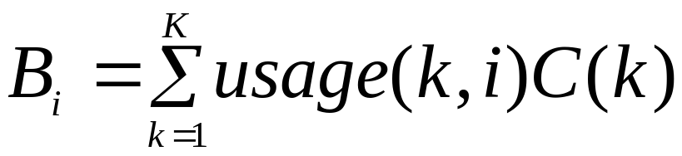
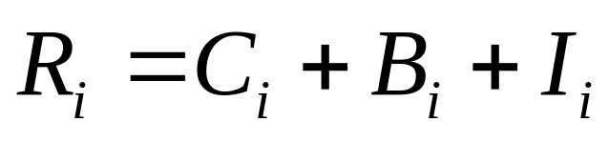
Calculating Blocking

Slide 15
Priority Ceiling Protocols
Two forms
Original ceiling priority protocol
Immediate ceiling priority protocol

Slide 16
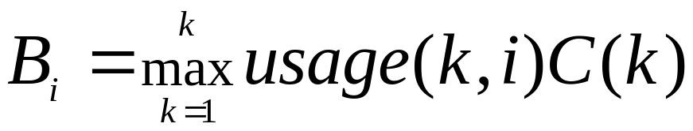
OCPP
Each process has a static default priority
Each resource has a static ceiling value defined, the maximum priority of the processes that use it
A process has the maximum of its own static priority and any it inherits due to it blocking higher-priority processes.
A process can only lock a resource if its dynamic priority is higher than the ceiling of any currently locked resource (excluding any that it has already locked itself)

Slide 17
OCPP Inheritance
Process
d
c
b
a
0
2
4
6
8
10
12
14
16
18

Slide 18
ICPP
Each process has a static default priority
Each resource has a static ceiling value, this is the maximum priority of the processes that use it.
A process has a dynamic priority that is the maximum of its own static priority and the ceiling values of any resources it has locked
As a consequence, a process will only suffer a block at the very beginning of its execution.

Slide 19
ICPP Inheritance
Process
d
c
b
a
0
2
4
6
8
10
12
14
16
18

Slide 20
On a Single Processor
A high-priority process is blocked at most once during its execution by lower-priority processes.
Deadlocks are prevented
Transitive blocking is prevented
Mutual exclusive access to resources is ensured by the protocol itself

Slide 21
OCPP versus ICPP
Although the worst-case behaviour of the two ceiling schemes is identical (from a scheduling view point), there are some points of difference:
  ICCP is easier to implement than the original (OCPP) as blocking relationships need not be monitored
  ICPP leads to less context switches as blocking is prior to first execution
  ICPP requires more priority movements as this happens with all resource usage
  OCPP changes priority only if an actual block has occurred

Slide 22
Simple Process Model
The application has a fixed set of processes
Sporadic and periodic processes have known T
All processes have a deadline …
The processes are independent of each other
All processes have a worst-case execution time
All context-switching costs etc. are ignored

Slide 23
Extensions
Cooperative Scheduling
Release Jitter
Arbitrary Deadlines
Fault Tolerance
Offsets
Optimal Priority Assignment

Slide 24
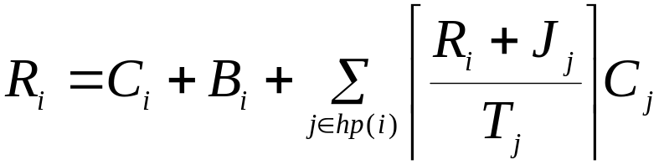

Release Jitter

Slide 25
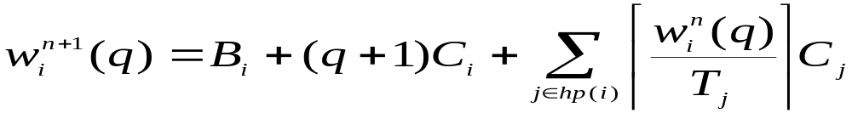


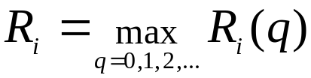
Arbitrary Deadlines

Slide 26
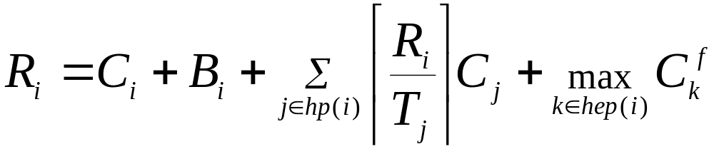
Fault Tolerance

Slide 27
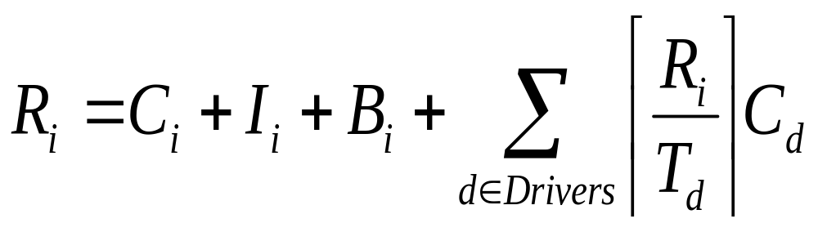
Interrupts
Drivers are treated as sporadic processes.

Slide 28
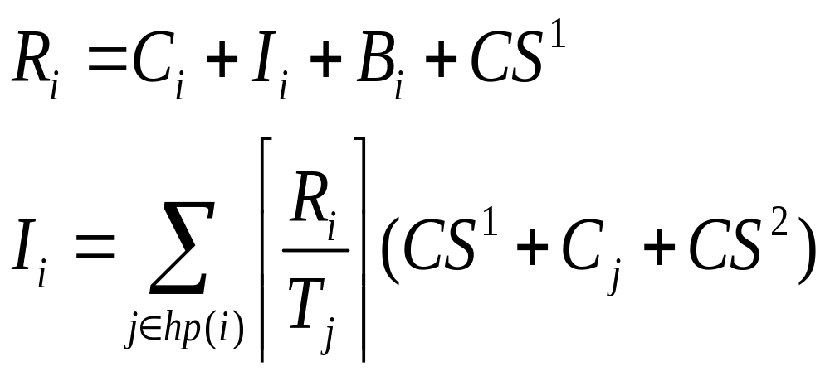
Context Switches
Chapter 16.3 and onwards …

Slide 29
The Schedulable Interface
public interface Schedulable extends java.lang.Runnable
{ public void addToFeasibility();
public void removeFromFeasibility();
public MemoryParameters getMemoryParameters();
public void setMemoryParameters(MemoryParameters memory);
public ReleaseParameters getReleaseParameters();
public void setReleaseParameters(ReleaseParameters release);
public SchedulingParameters getSchedulingParameters();
public void setSchedulingParameters(SchedulingParameters scheduling);
public Scheduler getScheduler();
public void setScheduler(Scheduler scheduler);
}

Slide 30
Scheduling Parameters
public abstract class SchedulingParameters
{ public SchedulingParameters(); }
public class PriorityParameters extends SchedulingParameters
{
public PriorityParameters(int priority);
public int getPriority(); // at least 28 priority levels
public void setPriority(int priority) throws
IllegalArgumentException;
...
}
public class ImportanceParameters extends PriorityParameters
{
public ImportanceParameters(int priority, int importance);
public int getImportance();
public void setImportance(int importance);
...
}

Slide 31
RT Java: Scheduler
Real-Time Java supports a high-level scheduler whose goals are:
  to decide whether to admit new schedulable objects according to the resources available and a feasibility algorithm, and
  to set the priority of the schedulable objects according to the priority assignment algorithm associated with the feasibility algorithm
Real-Time Java addresses more dynamic systems with the potential for on-line analysis

Slide 32
The Scheduler
public abstract class Scheduler
{ public Scheduler();
protected abstract void addToFeasibility(Schedulable s);
protected abstract void removeFromFeasibility(Schedulable s);
public abstract boolean isFeasible();
// checks the current set of schedulable objects
public boolean changeIfFeasible(Schedulable schedulable,
ReleaseParameters release, MemoryParameters memory);
public static Scheduler getDefaultScheduler();
public static void setDefaultScheduler(Scheduler scheduler);
public abstract java.lang.String getPolicyName();
}

Slide 33
The Priority Scheduler
class PriorityScheduler extends Scheduler
{
public PriorityScheduler()
protected void addToFeasibility(Schedulable s);
...
public void fireSchedulable(Schedulable schedulable);
public int getMaxPriority();
public int getMinPriority();
public int getNormPriority();
public static PriorityScheduler instance();
...
}
Standard preemptive priority-based scheduling

Slide 34
Summary
A scheduling scheme defines an algorithm for resource sharing and a means of predicting the worst-case behaviour of an application.
With a cyclic executive, the application code must be packed into a fixed number of minor cycles such that the cyclic execution of the sequence of minor cycles (the major cycle) will enable all system deadlines to be met
Simple utilization-based schedulability tests are not exact.

Slide 35
Summary
Response time analysis is flexible and caters for:
  Periodic and sporadic processes
  Blocking caused by IPC
  Cooperative scheduling
  Arbitrary deadlines
  Release jitter
  Fault tolerance
  Offsets
  ...

